Slide 1
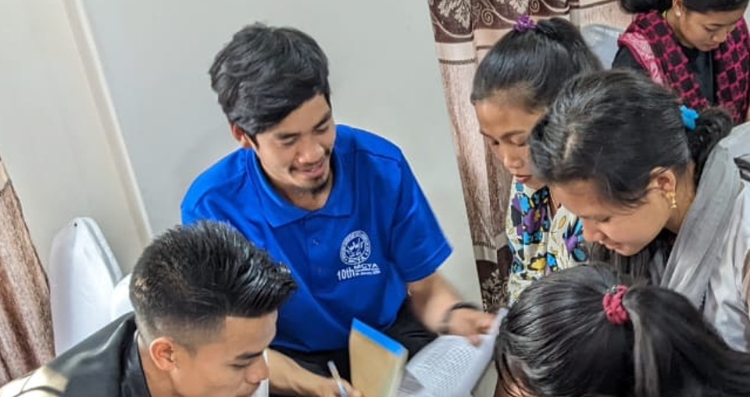
Scripture Engagement

Slide 2

What does it mean to be
engaged with Scripture?

Slide 3
?
Who remembers the 6 COBT behaviors?
Notes:
Les locuteurs de langue maternelle, en collaboration avec leur église locale, prennentla responsabilité de traduire la Bible dans la langue du cœur de leur communautélocale
L'église locale gère l'accessibilité de la communauté aux Écritures traduites.
Un raffinement et une révision continus auront lieu au sein de la communauté, avecdes locuteurs chrétiens de langue maternelle.
L'église engage la communauté locale dans l'utilisation des Écritures.
L'église locale partage le concept et la méthodologie de traduction de la Bibleappartenant à l'église avec d'autres communautés linguistiques.
L'église locale s'approprie les révisions et les mises à jour générationnelles desÉcritures.

Slide 4
The 6 Behaviors of Church-Owned Bible Translation
Mother-tongue speakers, in fellowship with their local church, take responsibility for translating the Bible into the heart language of their local community.
The local church manages community accessibility to the translated Scripture.
Continuing refinement and revision will take place within the community, with mother-tongue Christian speakers.
The church engages the local community in Scripture usage.
The local church shares the concept and methodology of church-owned Bible translation with other language communities.
The local church takes ownership of generational revisions and updates to the Scripture.
Notes:
You may remember, from when you were first trained by WA in Church-Owned Bible Translation (or COBT), that these are the 6 behaviors that follow from the 4 COBT beliefs of Ability, Authority, Responsibility, and Accountability. We are focusing here on the fourth behavior, the responsibility the church has for Scripture engagement in their own local community.

Slide 5
?
How is your community currently using Scripture?

Slide 6
?
How will your community use the newly translated Bible?
Notes:
Do you think the engagement level will stay the same or will it change?

Slide 7
?
How do you hope to see your community use the translated Bible?
What is needed so that this vision can become reality?
What kind of impact could this vision have on your community?
Notes:
Creating a plan – explain the purpose first before allowing time to discuss these questions.

Slide 8
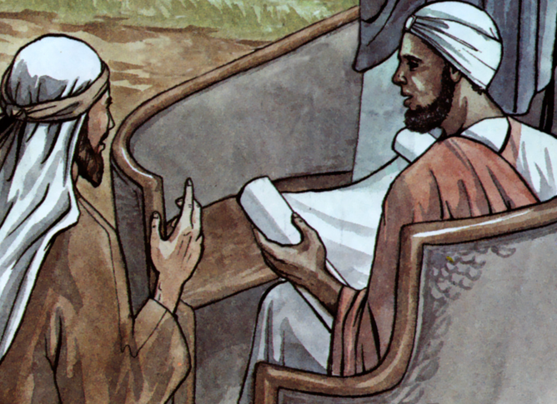
Acts 8:26–39
Group Bible Study
Notes:
Phase 2- WA SE service
Illustration from Good News Productions Inc. on freebibleimages.org, CC-BY ND, NC
Artist: Paula Nash Giltner

Slide 9
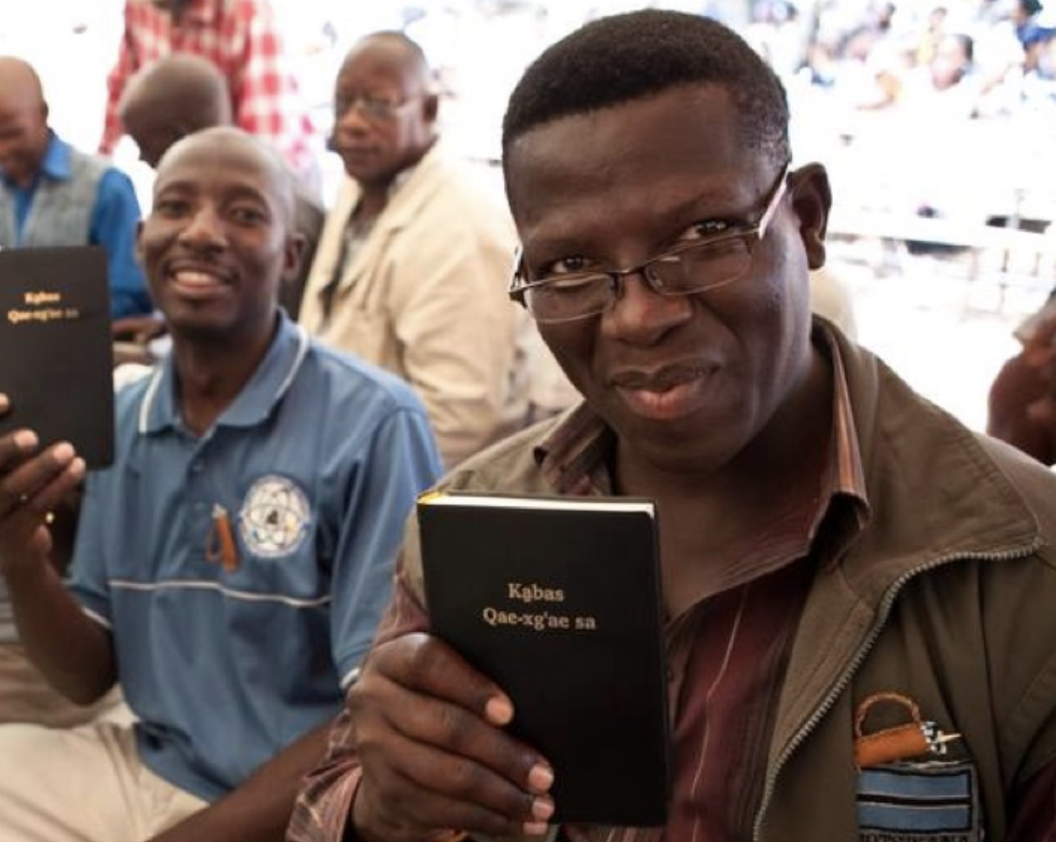
Scripture Engagement is a service for WA partners
who desire assistance.

Slide 10
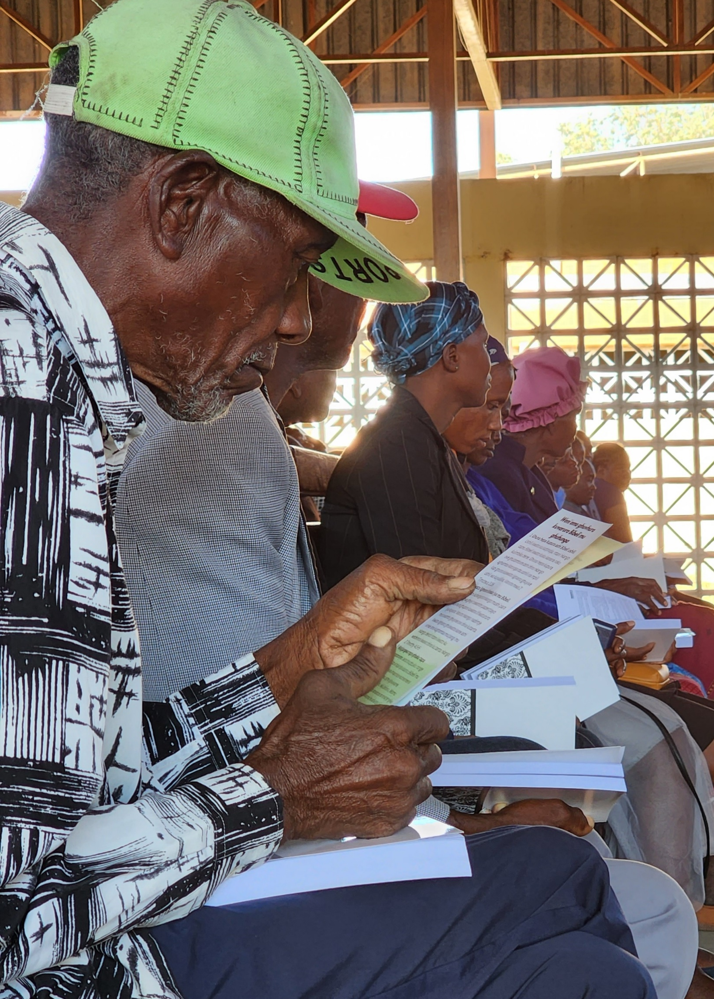
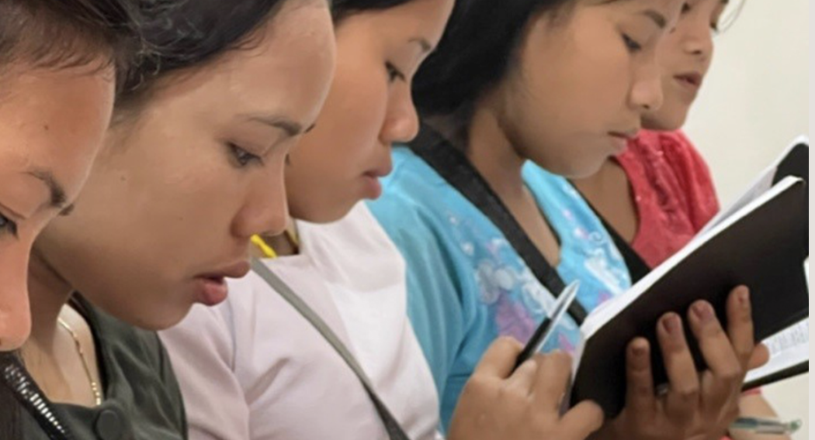
Scripture Engagement provides
training and resources
to help language groups become actively involved with
their newly translated Bible.

Slide 11
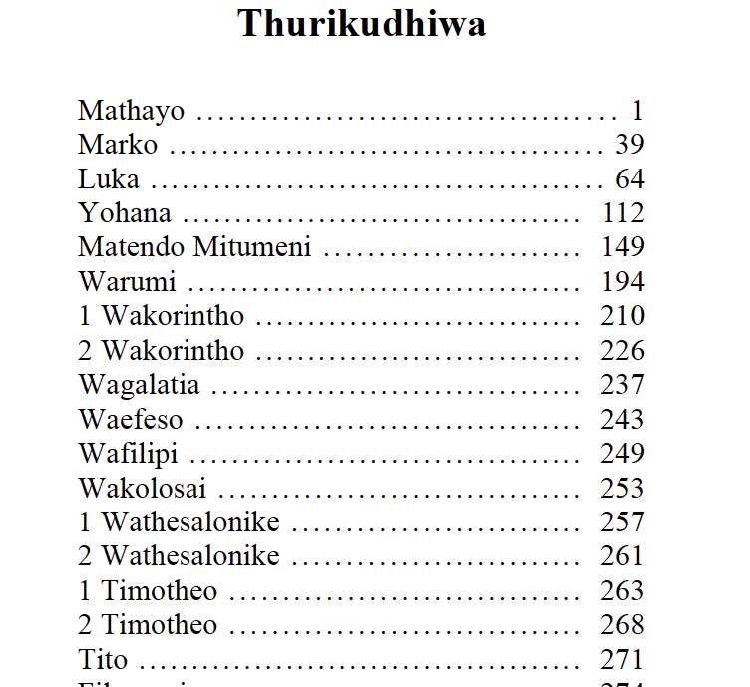
Resources can help people to use, love, and understand their Bible more.

Slide 12
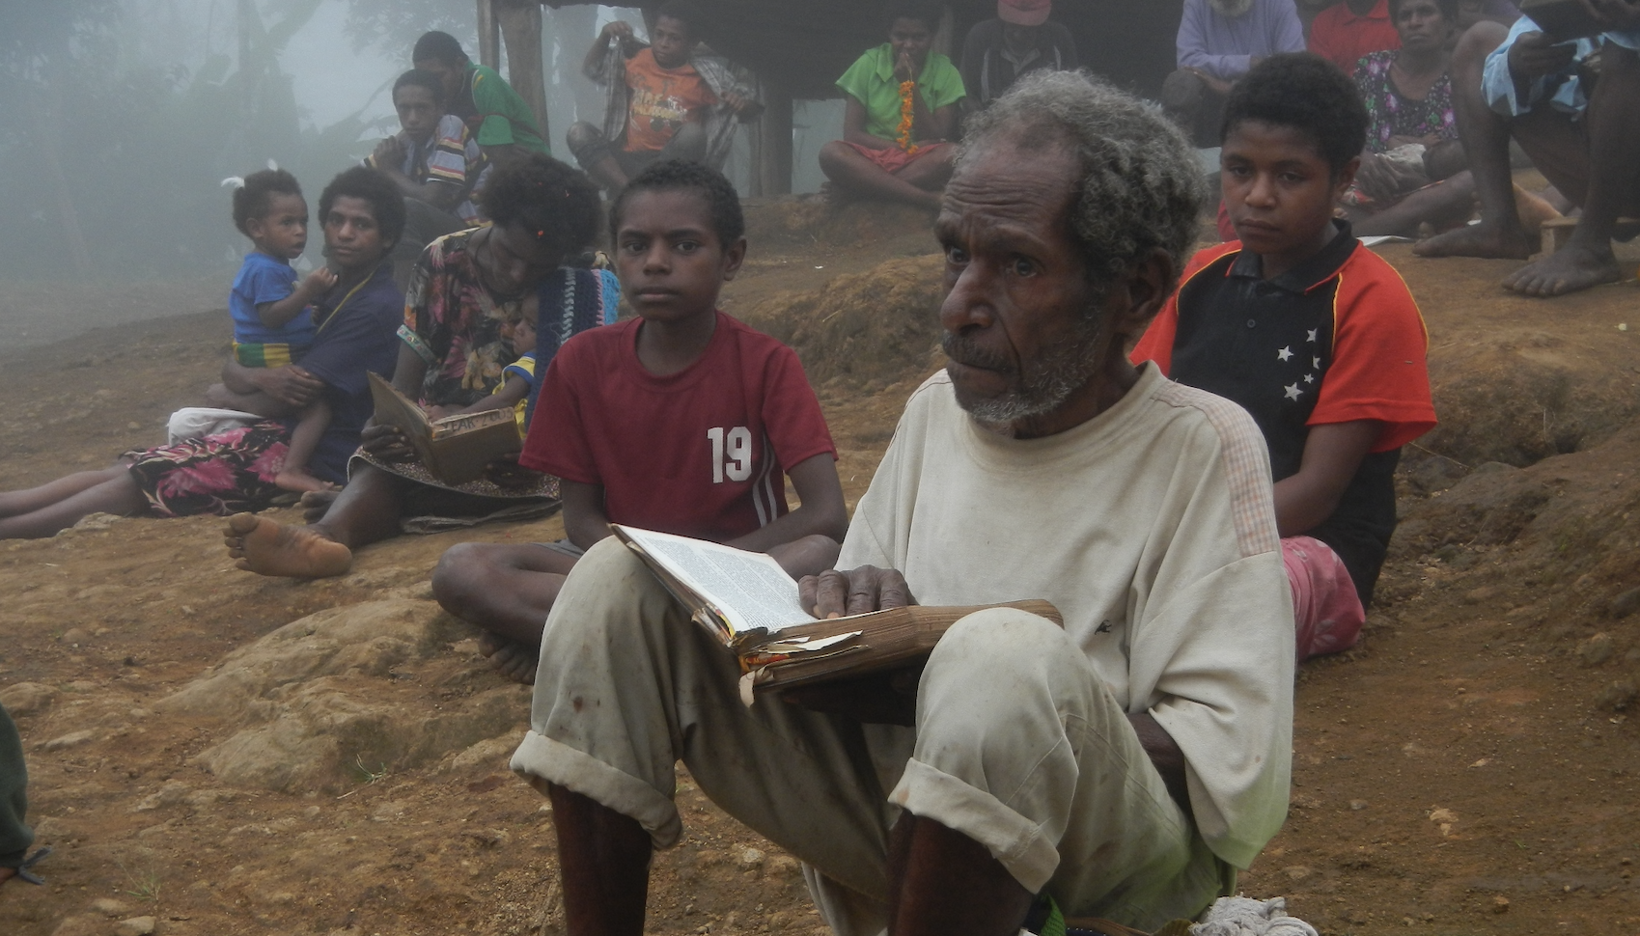
The goal is to help people:
Know where to start using Scripture
Use the Bible more often
Understand it more easily
Apply what it says to their lives
Gain a deeper relationship with Jesus

Slide 13
Examples of Scripture Engagement Resources
Topical devotionals
Bible studies for small groups

Slide 14
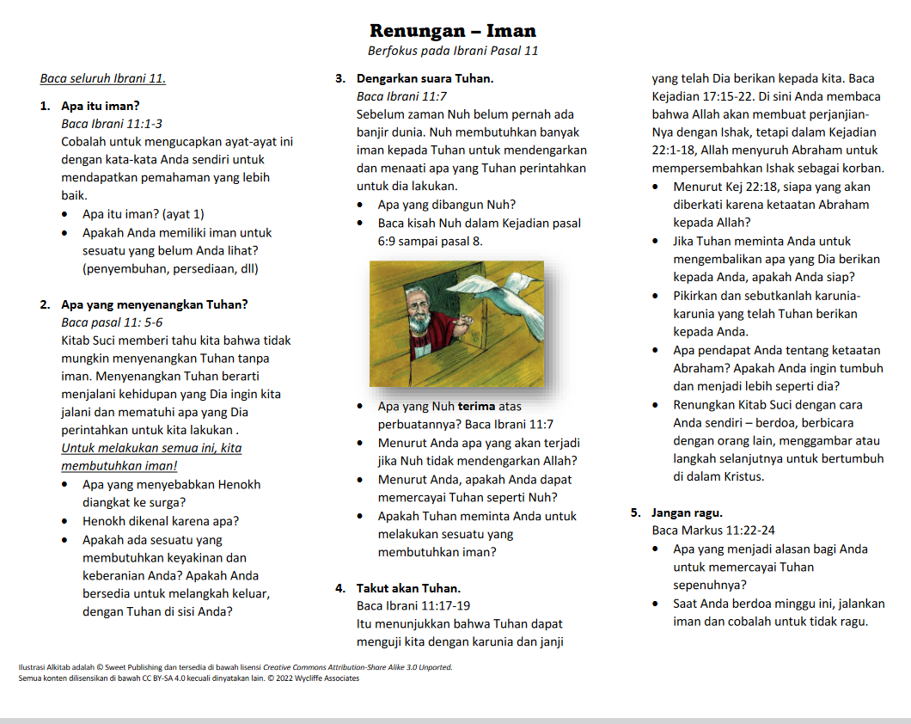
Notes:
This is a translated devotional about Faith with a focus on Hebrews chapter 11. The numbers 1-5 can represent days to read if desired. These devotionals can be used at home or at church study groups.

Slide 15
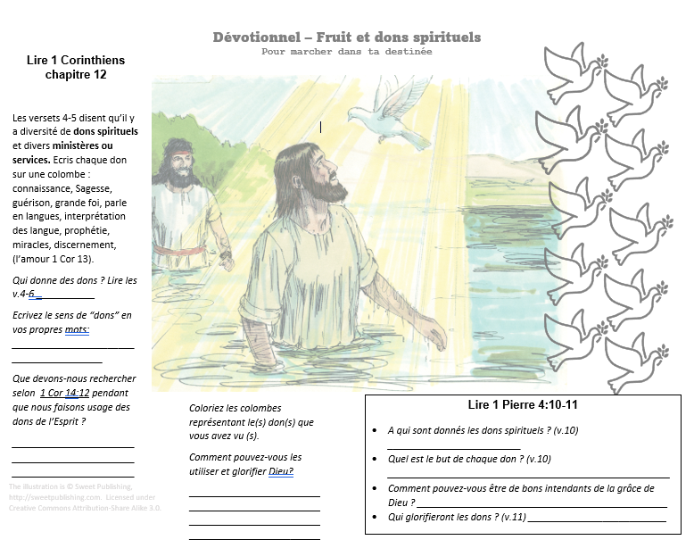

Slide 16
Examples of Scripture Engagement Resources
Topical devotionals
Bible studies for small groups
Reading plans / study question lists

Slide 17
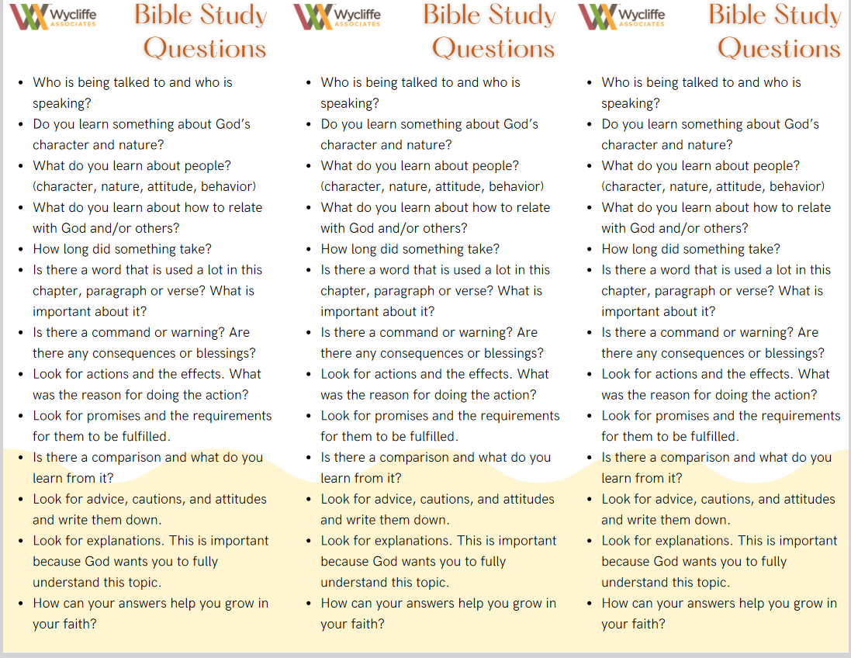
Notes:
These are 3 bookmarks on 1 page. Showing that we can provide resources that are cost-effective for the community.

Slide 18
Examples of Resources
Topical devotionals
Bible studies for small groups
Reading plans / study question lists
Basic guides and worksheets for leadership or for new believers

Slide 19
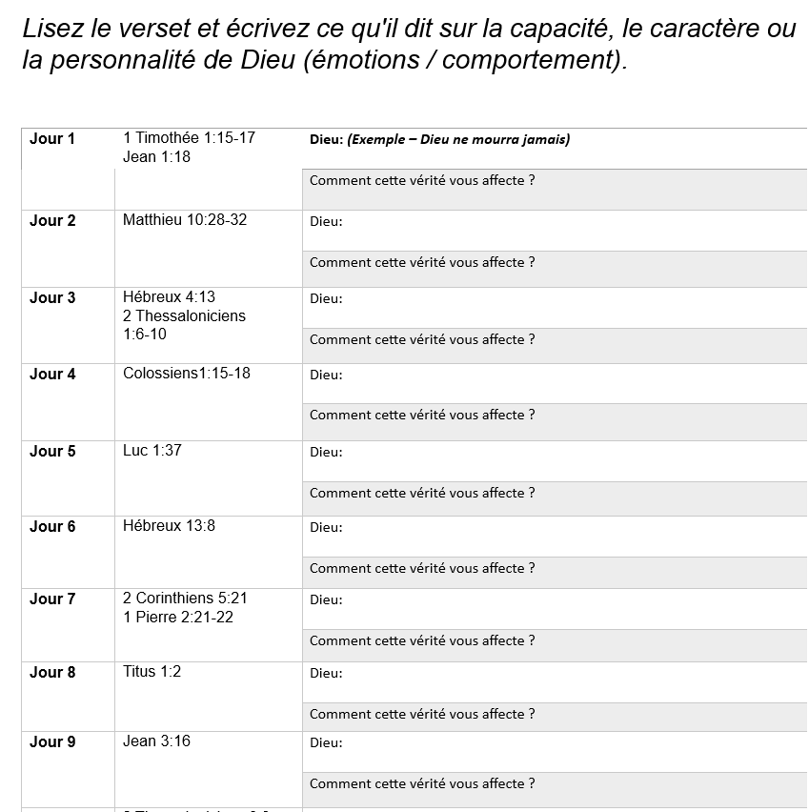
Notes:
Who is God worksheet – use to practice in the group to taste and experience the SE resources.

Slide 20
Examples of Resources
Topical devotionals
Bible studies for small groups
Reading plans / study question lists
Basic guides and worksheets for leadership or for new believers
Prayer card

Slide 21
Some language groups requested resources to:
Teach how to share the gospel
Help people develop a prayer habit
Study the Bible via different methods
Notes:
Each need is unique per language group. And we will do our best to help your community if desired.

Slide 22





Steps for Scripture Engagement Assistance
Plan
Consider help you need
Be ready to print your Bible
Fill out the SEA form

Slide 23
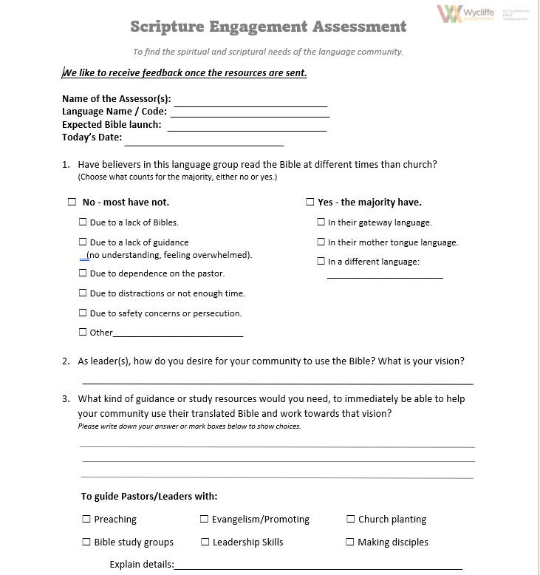
Scripture Engagement Assessment (SEA)
Notes:
Click on S.E.A. to review and create familiarity. Answer the translators’ questions if something is not clear. (Do not fill out the SEA form until ready to receive WA’s assistance.)

Slide 24


Steps for Scripture Engagement Assistance
Plan
Consider help you need
Be ready to print your Bible
Fill out the SEA form
Receive resources.
Translate if needed. Use them.
Follow up with WA

Slide 25
?
What if you
do not need
any assistance?
Help others:
Fill out the Biblical Outcome Form
Notes:
The BOF will be used once a language group has used their translated mother tongue Bible to receive accurate and more detailed testimonies. Someone from SE may reach out at a certain point.

Slide 26
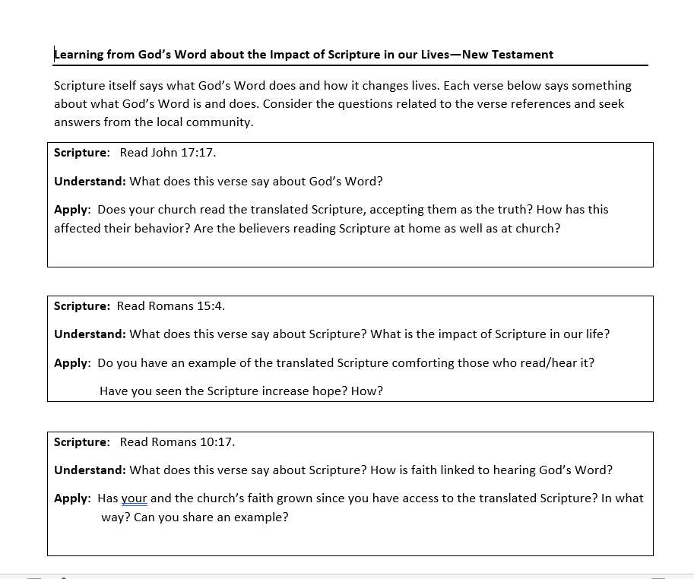
Biblical Outcome Form

Slide 27


